Slide 1
Linux device driver
Day 23 PPT
-SUBITHRA s

Slide 2
ltrace:
This tool is used to intercept and record the dynamic library calls that a program makes. Essentially, it helps you see which functions a program is calling from shared libraries (like libc). This can be useful for understanding program behavior, debugging, and performance analysis.
ltrace ./your_program
strace ./your_program
strace:
On the other hand, strace is used to trace system calls and signals that a program receives. This includes calls like open(), read(), write(), and so on. strace can provide detailed information about what system calls a program is making, which can be very helpful for debugging and understanding its interaction with the operating system.

Slide 3
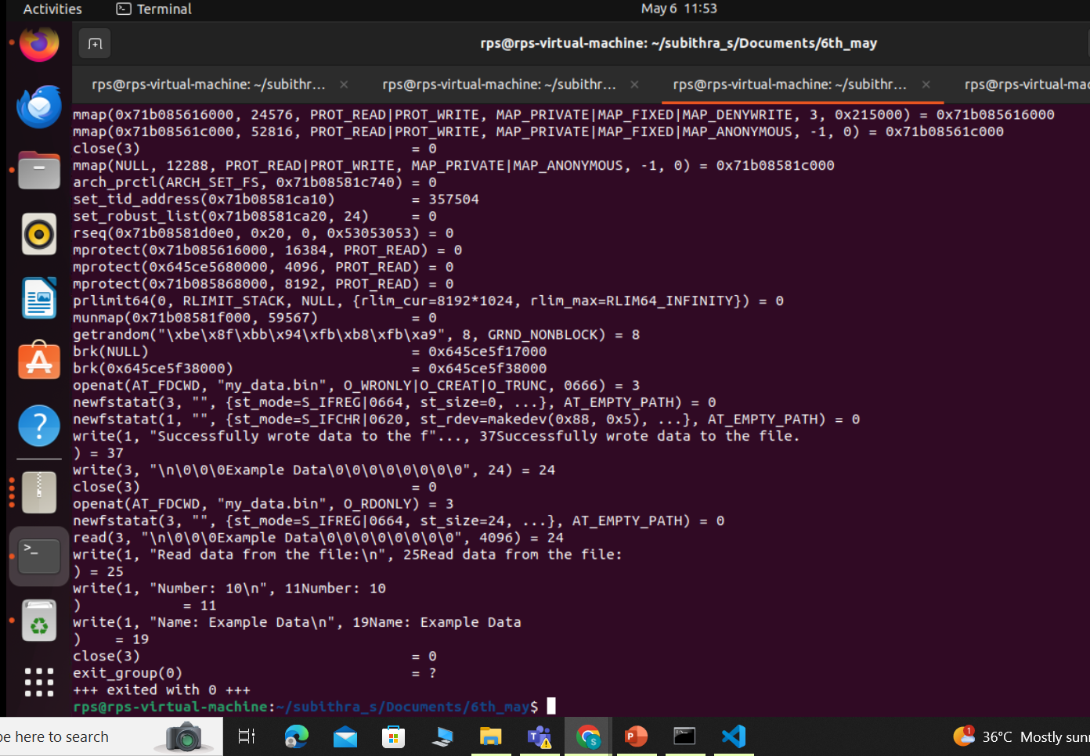
STRACE

Slide 4
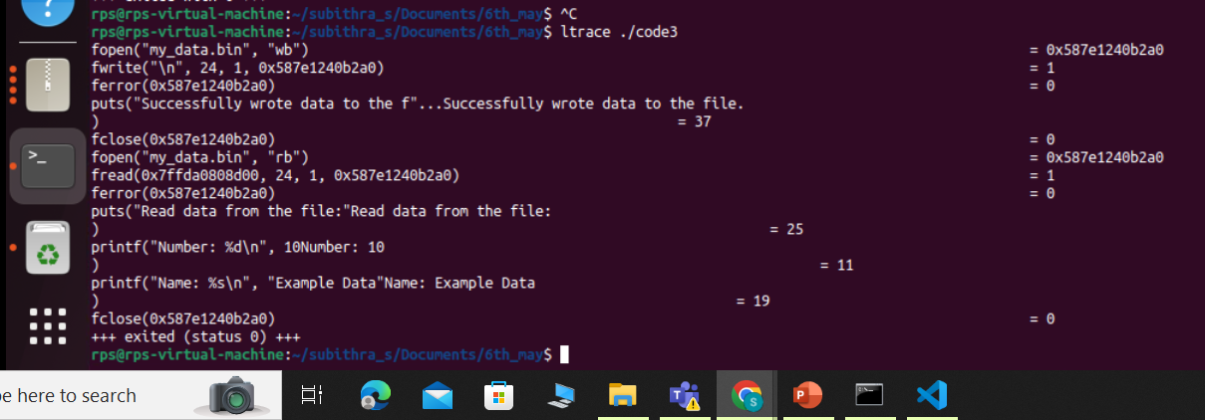
LTRACE

Slide 5
insmod :
The insmod command is used to insert a compiled kernel module into the running kernel. When you compile a kernel module, it generates a .ko file, which contains the code and data needed for that module. The insmod command takes this .ko file as input and loads the module into memory, making its functionality available to the kernel and user-space programs.
rmmod:
Removing a module in Linux involves unloading its code and data from the kernel's memory space. The rmmod command is used for this purpose. When you remove a module, the system checks for dependencies, decreases the module's reference count, and executes its cleanup routine. After removal, the module's functionality is no longer available, and system resources are freed up.
dmesg:
sudo: Runs the command with administrative privileges.
dmesg: Displays kernel log messages.
|: Redirects output to another command.
tail: Displays the last few lines of the kernel log.

Slide 6
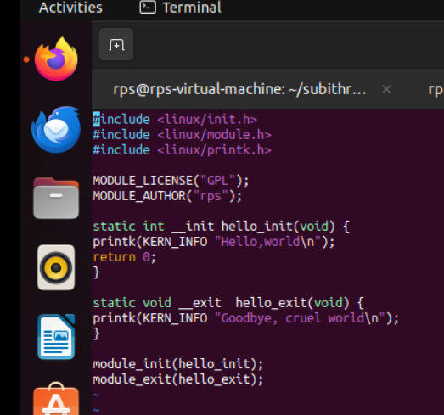
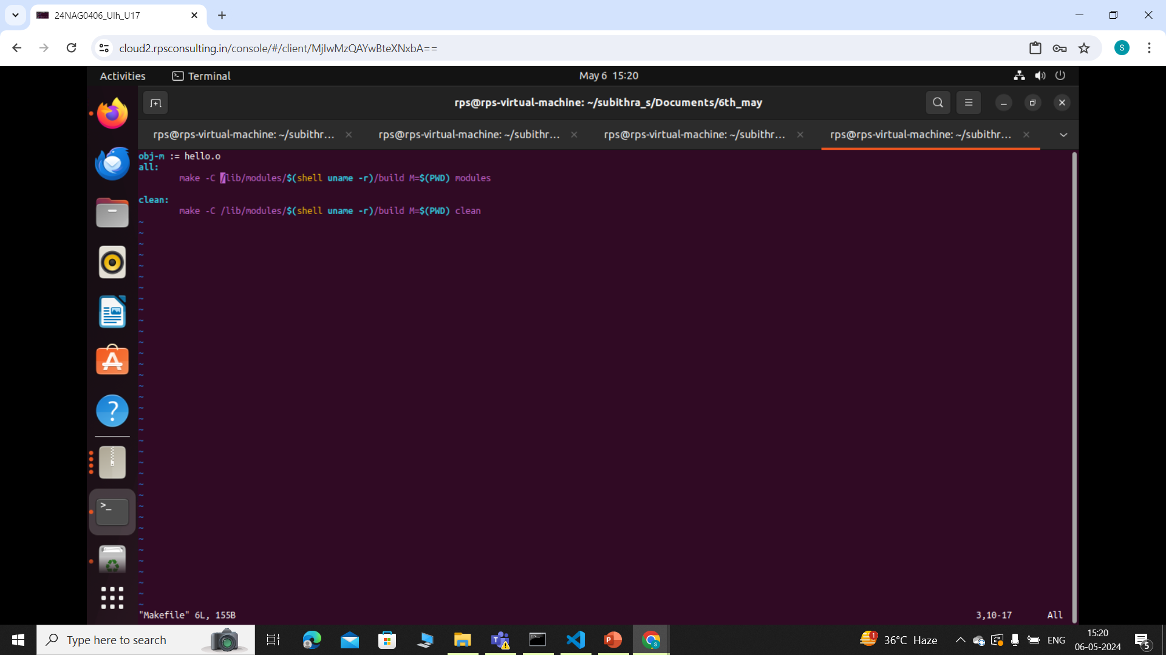

Slide 7
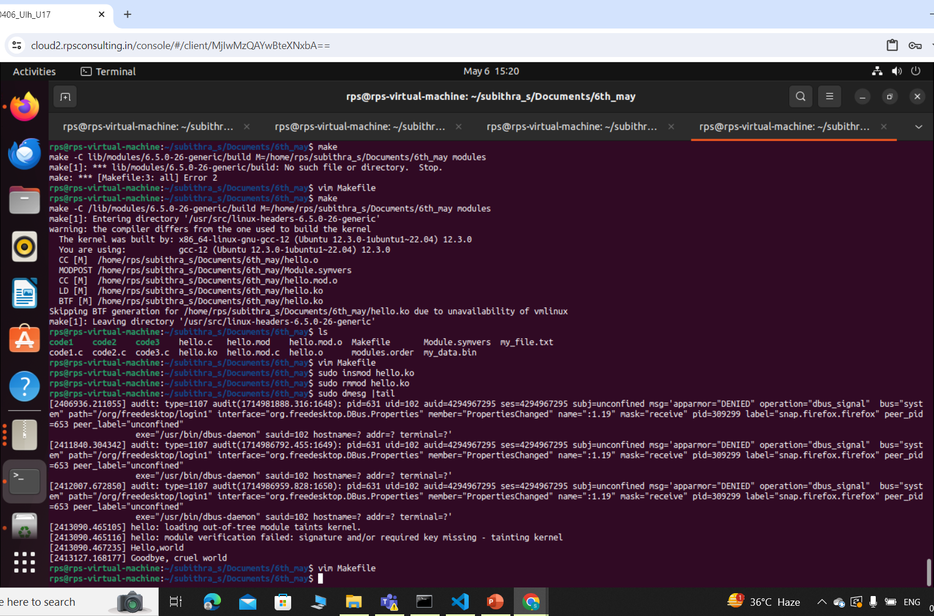

Slide 8
THANK YOU

